Slide 1


ICP Presentation
Name: JITEN CHAPAGAIN
Roll no: 13/ NPI000150
B.SC.IT 1st semester
Subject: Introduction to C programming
Sub teacher: Mr. Sushil Adhikari

Slide 2
Contents
Introduction to application
Design of program
Introduction to c programming
Basic c concepts used
Limitations
Conclusion
References

Slide 3
Introduction
Made for The Malaysia Red Crescent Society NGO.
C programming based application.
Non graphical application.
Designed to allow users to input, update, display, distribute, and remove data/material written in application.

Slide 4
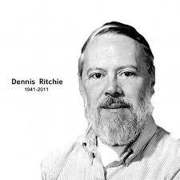
Introduction to c
developed by Dennis Ritchie(1941-2011) at AT & T bell laboratory in 1972 in USA.
C is a low level, compiled, general purpose and functional
programming language.
Notes:
General-purpose programming language means a programming language that is designed
to be used for writing software in a wide variety of domains. C is used to write software in wide varieties & it is capable of creating
all types of programs{can solve any problems.

Slide 5
PSEUDOCODE
pseudocode is a plain language description of the steps in an algorithm or another system.
Easy methods to describe a program.
Not a programming language.
Saves time of the programming.
People with no technical/computing can understand it.

Slide 6
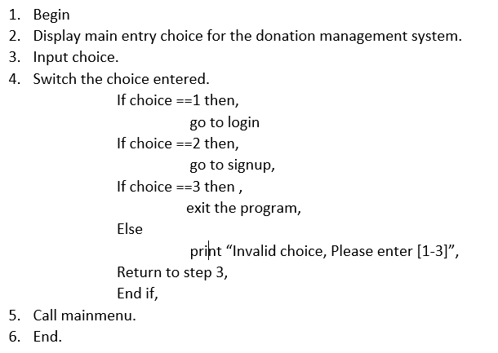
Sample of pseudocode

Slide 7
FLOWCHART
A flowchart is a graphical depiction of an algorithm that explains a workflow or process in a step-by-step method.
It illustrates the procedures as different sorts of boxes that are joined with arrows to represent their steps.

Slide 8
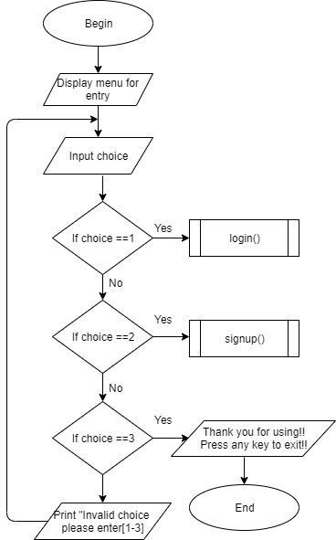
Flowchart samples

Slide 9
C concepts used in this application
Function
loop
Array
File handling
Pointer
structure

Slide 10
Functions in c
A function is a block of code that performs some action.
C is a functional programming
The biggest advantages of function is code can understood easily because function is a code cut into pieces and error can be find easily.
Predefined and user defined both functions were used in this application

Slide 11
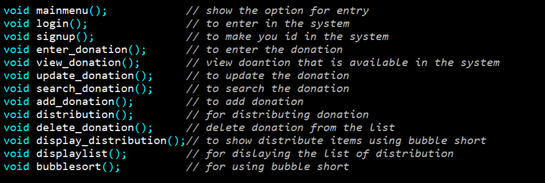
User defined function used
All user defined function used were shown already using flowchart.

Slide 12
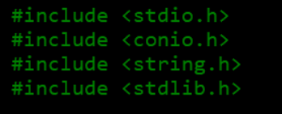
Library function used

Slide 13
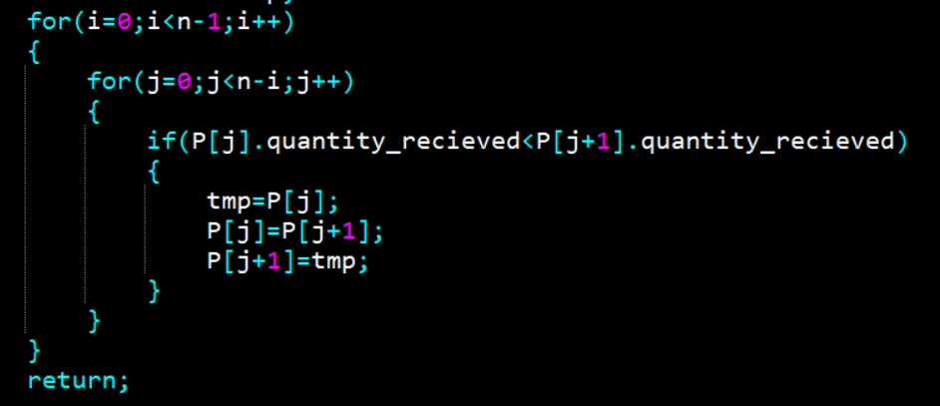
loop
In any programming language including C, loops are used to execute a set of statements repeatedly until a particular condition is satisfied.
There are 3 types of loops in c
Loop inside loop is also possible in c which is called nested loop.

Slide 14
array
An array is a variable that can store multiple values.
For example, if you want to store 100 integers, you can create an array for it. int data[100];
There are 2 types of array i.e one dimensional and multidimensional

Slide 15
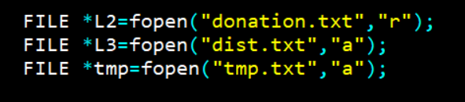
File handling
File handling in can be defined as a process of how user save available data and information in a file using a c programming
*used to open an existing file or a new file =fopen()
*writing data into an available file = fprintf()
*reading the data available in a file = fscanf()
*writing any character into the program file =fputc()
*reading the character from an available file = fgetc()
*used to close the program file = fclose()

Slide 16

pointer
Pointer can be defined as a type of variable who point the memory address of another variable as it’s value.
There are four arithmetic operators that can be used in pointers: ++, --, +, -
You can define arrays to hold a number of pointers.

Slide 17
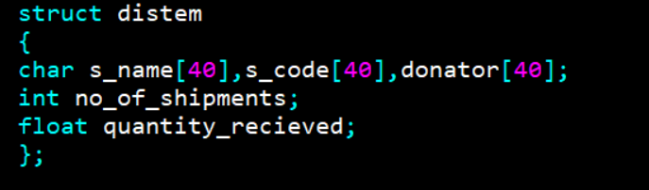
structures
Structure is a user-defined datatype in C language which allows us to combine data of different types together.
Structure helps to construct a complex data type which is more meaningful.
It is somewhat similar to an Array, but an array holds data of similar type only. But structure on the other hand, can store data of any type, which is practical more useful.

Slide 18
others
Jump statements like goto statement
Conditional statements (if else and elseif)
Switch statement
Variables
Keyword Datatypes & format specifiers

Slide 19
limitations
Non graphical
No data protection

Slide 20
Conclusion
This application reduces paperwork and frees up time for other tasks.
will surely increase the productivity of the NGO.
Doing this project, I improve my c language concept.

Slide 21
References
bubble sort flow chart. (2022, 06 29). Retrieved from softwareideas: https://www.softwareideas.net/a/1598/bubble-sort-flowchart-
c tutorial. (2022, 06 29). Retrieved from w3schools: https://www.w3schools.com/c/
c_pointers. (2022, 06 29). Retrieved from w3schools: https://www.w3schools.com/c/c_pointers.php#:~:text=A%20pointer%20is%20a%20variable,is%20created%20with%20the%20*%20operator.
File Handling in C. (2022, 06 29). Retrieved from bujus: https://byjus.com/gate/file-handling-in-c/#:~:text=The%20process%20of%20file%20handling,work%20again%20in%20any%20program.
jump statement in c. (2022, 06 29). Retrieved from scaler: https://www.scaler.com/topics/c/jump-statements-in-c/
What is Pseudocode? How to Use Pseudocode to Solve Coding Problems. (2022, 06 29). Retrieved from freecodecamp: https://www.freecodecamp.org/news/what-is-pseudocode-in-programming/

